Slide 1

Pulse Waveforms

Slide 2

Free Running Pulse Train
Also known as a square wave. Your lab bench function generators can do this.

Slide 3



One-Shot
“One shot” means one pulse, and that’s it.
3 one-shots with short on time:
Could be irregularly spaced, with irregular on time:

Slide 4
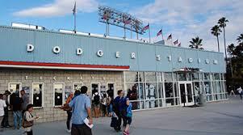

Using One Shot Example
Fans coming into Dodger Stadium. They don’t come in on a rhythm, and some stay longer in the turnstiles than others.
Extended to 16 bits, your lab counter can get one game’s attendance. They’ll count one-shots.

Slide 5

2 One-Shots with long on time
We don’t know how long that third pulse will be on.

Slide 6
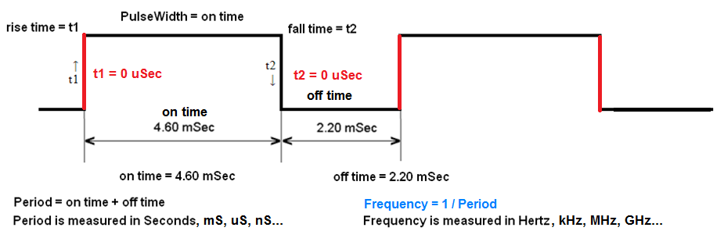
Pulse Waveform Characteristics Theoretical or Ideal
The “Ideal” thing is that the pulse rises and falls in zero time. Hah! That’s a fairy tale.

Slide 7
Frequency and Period
See that frequency formula at the bottom right of last slide?
Frequency = 1 / Period
Frequency is measured in Hertz, kHz, MHz, GHz…
So, by algebra,
Period = 1 / Frequency
Period is time! It’s ns, μs, ms, seconds, minutes… years…

Slide 8
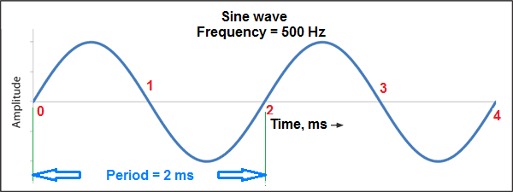
Well, It’s Not So Simple…
Frequency = 1 / Period only for a pure sine wave.
But for our square pulses,
Frequency = n / Period
Where n = 1 is the fundamental; n = 2 is the 2nd harmonic…

Slide 9
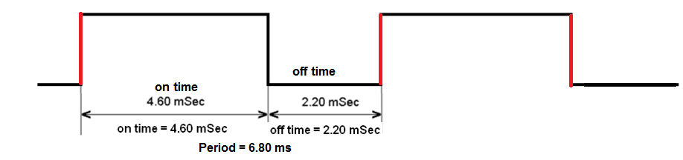
Let’s Look at Those Pulses…
Frequency = n / Period
Where n = 1 is the fundamental; n = 2 is the 2nd harmonic…
But for our square pulses,
Frequency = n / 0.0068 s
= 147 Hz, 294 Hz, 441 Hz, 588 Hz…

Slide 10
Frequency and Period Example
Period = half a second. What is the fundamental frequency?
Frequency = 1 / period
= 1 / 0.5s
= 2 Hz
For a quiz, you only need to know fundamentals. In 4th year and college, you’ll do the others.

Slide 11
Frequency and Period Example (2)
Fundamental frequency = 1 kHz. What is the period? Remember what kilo means…
Period = 1 / frequency
= 1 / 1000 Hz
= 1 ms
Remember what milli means?

Slide 12
Frequency and Period Example (3)
Fundamental frequency = 146.52 MHz. What is the period?
Period = 1 / frequency
= 1 / 146,520,000 Hz
= 6.825 ns
146.52 MHz is the national ham radio 2-meter simplex calling frequency. We DON’T want the 2nd harmonic, which would interfere with garage door openers using 293.04 MHz.

Slide 13
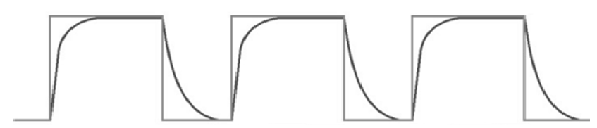
Practical Pulse Waveform
This is “Practical” because the pulse takes some time to rise and fall. That’s the real world, baby…
Note how the last halves of the rise and fall take more time than the earlier half…

Slide 14
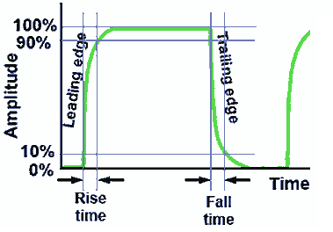
Practical or Real Pulse Waveform Characteristics
Getting 90% of the max pulse voltage is high enough to be “on”.
Dropping to 10% of the max pulse voltage is low enough to be “off”.

Slide 15
Practical or Real Pulse Waveform Characteristics (2)
So, we don’t wait for the rise to get to 100% or down to 0%. 90% or 10% is enough.

Slide 16
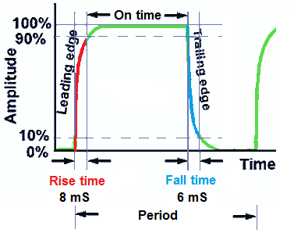
Practical or Real Pulse Waveform Characteristics (3)
Rise time = 8 mSec
Fall time = 6 mSec. They don’t have to be equal.

Slide 17

Duty Cycle
Ratio of On Time to Period
Percentage (%) of the waveform’s period

Slide 18

Duty Cycle Example
On time = 40 ns. Off time = 60 ns. How long is the period?
Duty cycle = on time / period
= 40ns / (40ns + 60ns) x 100%
= 40%

Slide 19

Duty Cycle Example (2)
On time = 9 hours. Off time = 1 hour. How long is the period?
Duty cycle = on time / period
= 9 h / (9 h + 1 h) x 100%
= 90%
What’s your prayer duty cycle?

